Slide 1
Control of Hazardous Energy (Lockout/Tagout)
Standard 29 CFR Part 1910.147
Presented by: Barton Insurance Group LLC
© 2005, 2012, 2020 Zywave, Inc. All rights reserved.

Slide 2
Learning Objectives
After this training program, participants will understand:
When lockout procedures are required
What sources of hazardous energy are
How to execute basic procedures for locking out and restarting equipment
When alternative energy control procedures come into play

Slide 3
What Is Lockout?
The goal of machine lockout is to prevent the accidental energization or start up of equipment.
Lockout procedures are completed by isolating the energy sources of a machine and then physically locking them so they cannot be re-energized.

Slide 4
What Makes Lockout Procedures Effective?
Employees working inside the hazardous area of a machine are protected by a lock.
The only person who can remove the lock is the employee who originally put it on.

Slide 5
What Is Tagout?
The term “tagout” is often used alongside “lockout.”
Tagout procedures are similar to lockout in that they are meant to control hazardous energy.
However, with tagout procedures, machines cannot be physically locked out. Instead, the machine’s energy is isolated and a tag is placed on the equipment as a warning to employees.
Tagout procedures are not as effective as lockout ones, as tags might not be seen by employees.
Tagout procedures may not be used if the machine can be locked.
Tagout procedures are becoming rare, as new and retrofitted equipment are required to accept locks.

Slide 6
Authorized and Affected Employees
Authorized employee–This refers to an employee who is trained and authorized to perform work requiring the identification and control of energy sources. Generally, this work is service or maintenance related.
Affected employee–This refers to an employee who does not use lockout/tagout procedures, but works in an area where equipment may include locks and tags on energy control devices.

Slide 7
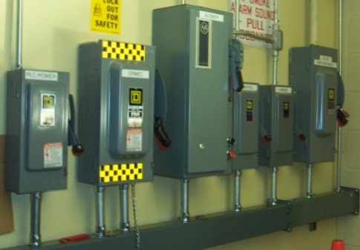
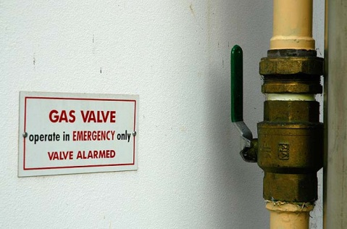
Energy Sources
Energy sources, which are present in many machines, may be:
Electrical
Mechanical (e.g., moving parts)
Pneumatic and gas
Hydraulic
Thermal (e.g., heat or extreme cold sources)
Chemical (e.g., acids, bases or solvents)
Stored (e.g., energy that is stored even after the control device is locked)

Slide 8
Stored Energy
Many serious accidents occur because stored energy was not recognized. Some examples of where stored energy can be found include:
Charged electrical capacitors
Compressed springs and wound torsion bars
Hot machine parts
Pressurized pipe lines
A machine part that can slide if a catch fails
A critical step of any lockout procedure is to release stored energy and verify that all stored energy sources have been rendered safe before starting work.

Slide 9
Energy Control Procedures
We have developed energy control procedures for each applicable piece of equipment.
Procedures are available to employees at all times.
New equipment must have an approved energy control procedure before it can be put into service.
If you ever notice that an energy control procedure is missing, notify your supervisor immediately.

Slide 10
Locks
Authorized employees will be issued locks, which should have just one key.
Lockout locks will have a distinct look and can only be used for lockout procedures. This ensures lockout locks are consistent and that affected employees can easily recognize a lockout.
Tags should be used with a lock. This serves as a warning of hazardous energy and helps identify who originally placed the lock.

Slide 11
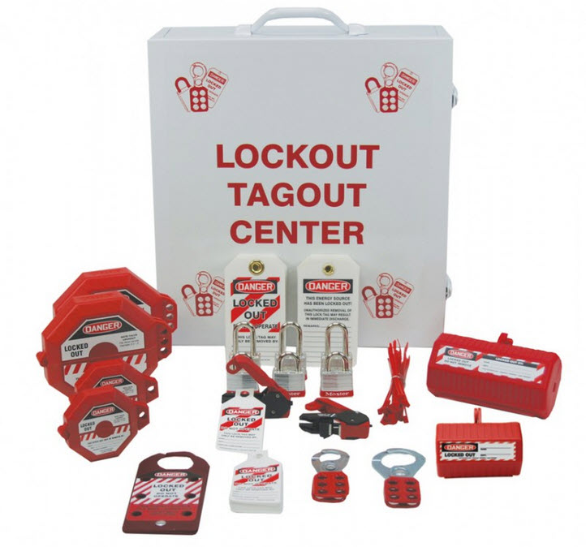
Additional Lockout Equipment
While some energy isolating devices may accept a lock, others will not without additional equipment.
Additional lockout equipment can include gate valves, ball valves and plug covers, among others.
If group lockout that accepts multiple locks is preformed, a hasp will be needed.

Slide 12
Lockout/Tagout Preparation
To prepare to perform a job requiring lockout/tagout you must:
Review the energy control procedure.
Procure all hardware needed to lockout all energy sources.
Complete all information needed on your tag(s).

Slide 13
Lockout Sequence
Every piece of equipment has its own specific procedure. However, the following are some lockout sequence best practices to consider:
Notify affected employees that the machine will be shut down.
Identify the types and magnitude of energy involved in the lockout.
Shut down the equipment using a standard stopping procedure.
Isolate the energy sources.
Lock out the energy sources with the appropriate devices and locks.
Dissipate or restrain any stored energy in the machine.
Test the machine to ensure the procedure was effective. No employees should be nearby when this happens. Return the machine’s controls to a safe position after verification concludes.

Slide 14
Restoration of Energy
Check the machine or equipment and the immediate area around the machine to ensure that nonessential items have been removed and that the machine or equipment components are operationally intact.
Check the work area to ensure that all employees have been safely positioned or removed from the area.
Verify that the controls are in neutral.
Remove the lockout devices and reenergize the machine or equipment. Note: The removal of some forms of blocking may require reenergization of the machine before safe removal can be completed.
Notify affected employees that the servicing or maintenance is completed and the machine or equipment is ready for use.

Slide 15
Multiple Employee Lockout
Whenever more than one employee is working on equipment requiring lockout/tagout, the following rule applies:
Each employee must have her or his lock on each energy control.
A group lockbox could also be used.
If an employee is working on a piece of equipment, even for a minute, they must always lock out. They can remove their lock when they are no longer working on the piece of equipment.

Slide 16
Shift Change or Reassignment
When shift change or reassignment occurs during a lockout/tagout, the following rules apply:
The off-going employee will review the job with the on-coming employee.
The off-going employee will remove his or her locks/tags.
The on-coming employee will place his or her locks/tags.
The on-coming employee will verify that all energy controls are in the off or safe position.
Always check your lockout/tagout after being away from the job, even after breaks and lunch.

Slide 17
Emergency Lock Removal
In the event that a lock has to be removed when an employee cannot be contacted, the following procedure will be followed:
The decision to remove the lock must be made by a member of management.
A form must be filled out by an authorized supervisor before a lock can be removed.
Every effort must be made to contact the employee including calling her or him at home.
A member of management will meet the employee at the entrance before the next scheduled work shift.
The cut-off lock will be left with a note on the employee’s bench or tool box.

Slide 18
Cord and Plug Exception
If a piece of equipment is connected to a power source using a cord and plug, and the exposure to hazardous energy can be controlled by unplugging the cord and having exclusive control of the plug, lockout is not necessary.

Slide 19
Alternative Procedures for Minor Tool Changes, Adjustments and Other Minor Servicing
Lockout is also not required if:
Work is routine, repetitive and integral AND
There are alternative measures in place that provide effective protection.
This is not to be taken lightly. Documented procedures and risk assessments must be completed for these activities. If you’re ever in doubt, use full lockout procedures.

Slide 20
Working With Contractors
Contractors are required to have a program equivalent to ours.
Contractor personnel will be made aware of our procedures, locks and tags.
All of our facility personnel who work with contractors will be made aware of the contractor procedure, locks and tags.
Any problems that you observe should be immediately brought to the attention of the program administrator.

Slide 21
Periodic Inspections
Annually, an inspection must be done to ensure that lockout procedures are accurate and employees understand these procedures.
As part of these inspections, we will:
Review all energy control procedures.
Revise energy control procedures when applicable.
Conduct retraining when energy control procedures need to be revised.

Slide 22
Summary
Lockout procedures are used in our facility any time an employee could be exposed to hazardous energy from a machine should it start up inadvertently. Only facility- assigned locks and tags are to be used.
Always check the energy control procedure prior to performing a lockout/tagout - never forget to check for stored energy.
Communicate with all personnel who are affected by the job.
Each employee working on the job must have his or her lock on each energy control device.

Slide 23
For More Information
For more information regarding the control of hazardous energy or other safety issues, please contact:
Barton Insurance Group LLC
www.bartoninsurancegroupllc.com
615.806.1265

